Slide 1
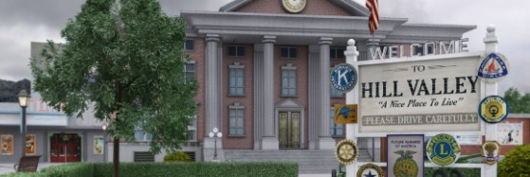
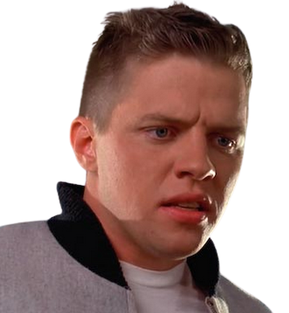
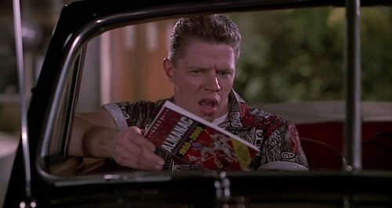



Decades after Hill Valley High School Biff Tannen’s life is revealed when his estranged son discovers that his father’s dangerous past is colliding with own future.

